Slide 1
CUSTOMER SHOPPING
BEHAVIOR ANALYSIS
An End-to-End Retail Analytics Project
PYTHON • SQL • POWER BI
Prepared by Ankit Mishra | August 2026

Slide 2
Executive Summary
3,900 retail transactions analyzed end-to-end — from Python data cleaning through SQL analysis to an interactive Power BI dashboard — to guide marketing, pricing, and retention strategy.
3,900
$59.76
3.75 / 5
Transactions Analyzed
Avg. Purchase Amount
Avg. Review Rating
27%
80%
68%
Customers Subscribed
Loyal Segment Share
Revenue from Male Customers
Customer Shopping Behavior Analysis
2

Slide 3
Project Overview
Dataset Summary
Toolchain
3,900 rows × 18 columns of transactional data
Customer demographics: Age, Gender, Location, Subscription Status
Purchase details: Item, Category, Amount, Season, Size, Color
Behavior signals: Discounts, Promo Codes, Review Rating, Shipping, Frequency
37 missing Review Rating values imputed by category median
P
Python
Data loading, cleaning, and feature engineering with pandas
S
SQL
structured queries answering core business questions
P
Power BI
Interactive dashboard for stakeholder self-service
Customer Shopping Behavior Analysis
3

Slide 4
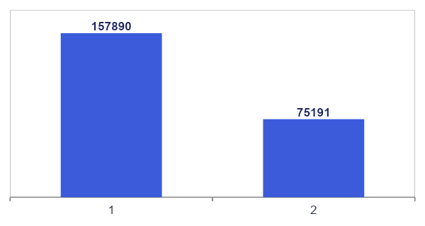
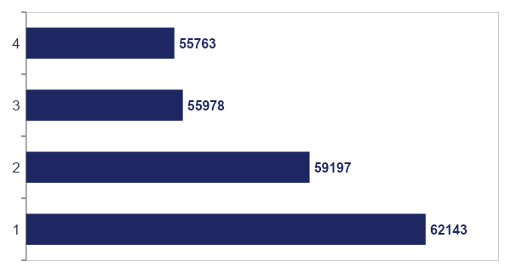
Revenue Insights
Revenue by Gender
Revenue by Age Group
Male customers drive 68% of total revenue ($157,890 vs. $75,191).
Revenue is fairly even across age groups — Young Adults lead by ~11% over Seniors.
Customer Shopping Behavior Analysis
4

Slide 5
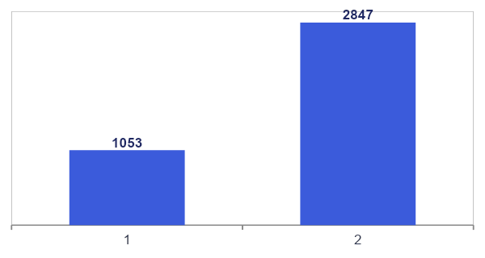
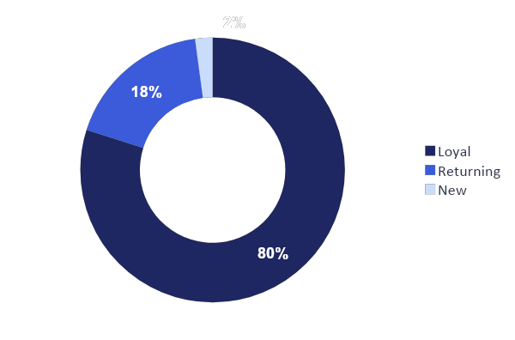
Customer Behavior
Subscribers vs. Non-Subscribers
Customer Segmentation
Only 27% of customers subscribe, yet subscribers spend almost the same as non-subscribers ($59.49 vs $59.87) — growth lies in acquisition, not spend.
Loyal customers make up 80% of the base; the New-customer pool (2%) is the tightest growth constraint.
Customer Shopping Behavior Analysis
5

Slide 6
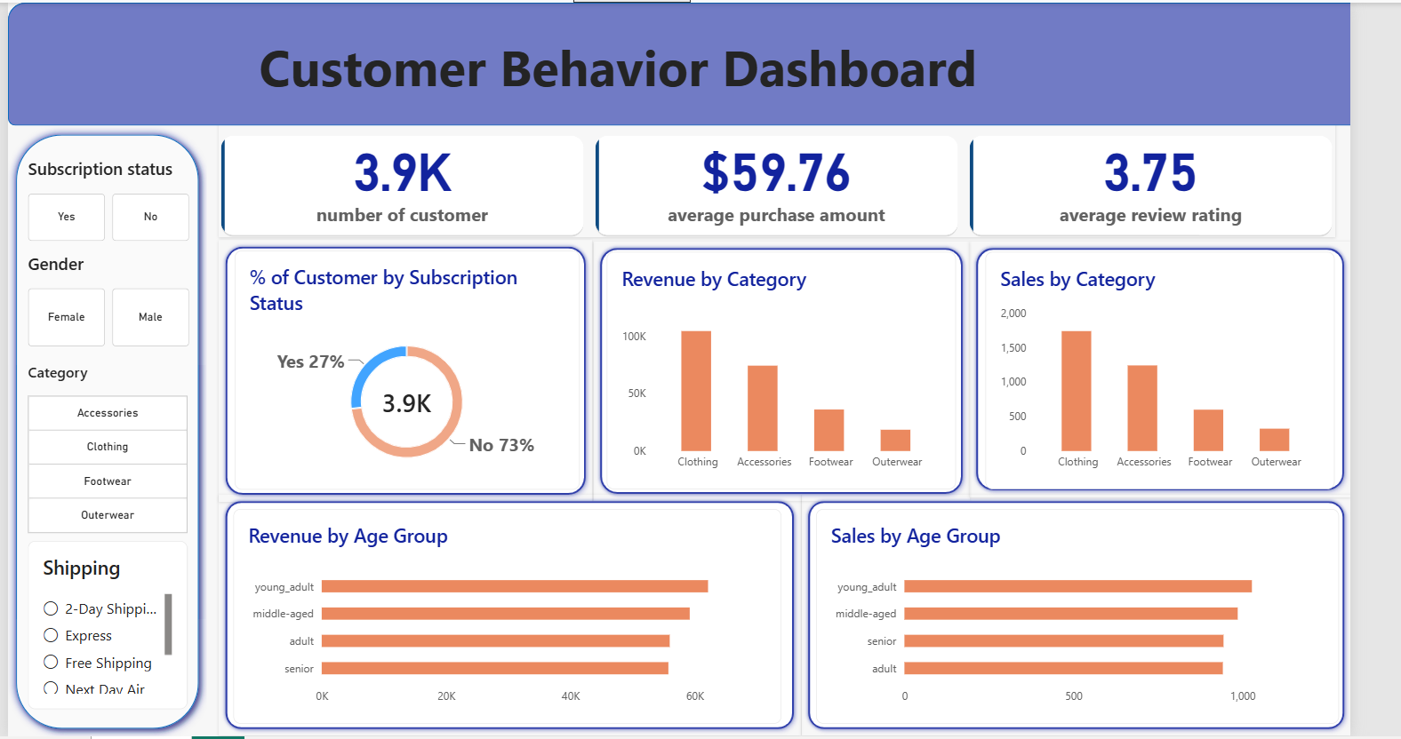

Slide 7
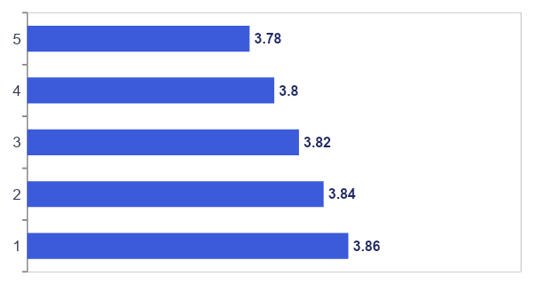
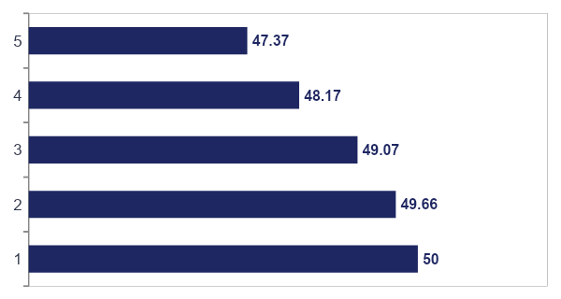
Product Insights
Top 5 Products by Rating
Highest Discount-Dependency
Ratings cluster tightly at the top — no single standout, broad quality across the catalog.
Nearly half of all purchases in these 5 lines involve a discount — the clearest margin-risk area.
Customer Shopping Behavior Analysis
6

Slide 8
Interactive Dashboard in Power BI
The cleaned dataset and SQL findings were brought together into a self-service Power BI dashboard, letting stakeholders explore revenue and sales patterns without writing a single query.
1
Cross-Filtering
2
Headline KPIs
Slicers for Subscription Status, Gender, Category, and Shipping Type
3.9K customers, $59.76 avg. purchase, 3.75 avg. review rating at a glance
3
Category Breakdowns
4
Subscription Split
Revenue and sales by product category and age group
Donut chart confirming the 27% / 73% subscriber split
Customer Shopping Behavior Analysis
7

Slide 9
Business Recommendations
1
Boost Subscriptions
Grow the subscriber base — not just spend — by converting high-frequency repeat buyers with tangible perks.
2
Strengthen Loyalty
Move Returning customers into the Loyal tier and widen the thin New-customer acquisition pipeline.
3
Review Discount Policy
Shift Hat, Sneakers, Coat, Sweater, and Pants from blanket discounts to targeted, margin-conscious offers.
4
Spotlight Top Products
Feature consistently top-rated and top-selling items in campaigns and merchandising.
5
Target Marketing Spend
Prioritize the Young Adult segment and Express-shipping customers for incremental spend.
Two consistent themes emerge: subscription and loyalty are under-leveraged as revenue drivers, and a small set of product lines carry disproportionate discount dependency. Addressing both offers a clear, data-backed path to improving revenue and margin.
Customer Shopping Behavior Analysis
8

